Slide 1
Bing Ads Universal Event Tracking (UET) Feature

Slide 2
Session Overview
What Is Universal Event Tracking (UET)?
Universal Event Tracking Benefits
How Does Universal Event Tracking Work?
UET Goal Types
Implementing Universal Event Tracking Tags
Appendix
Notes:
At the end of this course you’ll be able to:
Navigate Bing Ads Editor
Upload bulksheets to Bing Ads
Use best practices and shortcuts to make bulk edits across campaigns
Utilize filters to improve upon performance"

Slide 3
What Is Universal Event Tracking?
Universal Event Tracking (UET) is a mechanism for advertisers to report user activity on their websites to Bing Ads by installing one site-wide tag
It is a useful and effective method to track what happens after someone has clicked on an ad
UET is a prerequisite for advertisers to track conversions and / or perform remarketing. Once the UET tag is installed by an advertiser across their website, the tag reports user activity on that advertiser’s website to Bing Ads

Slide 4

Universal Event Tracking Benefits
Saves Time and Effort
Improve
ROI
Better Campaign Attribution
Audience-Based
Remarketing buying
Visibility Into Conversion Data For Sales Teams
Site has to be tagged once.
No need to generate new tags each time a new account or conversion goal is added
Measure and optimize campaigns more effectively by going beyond impressions and clicks
Enables advertisers to analyze how their customers interact & convert across devices, campaigns, and accounts for better insights
Enables advertisers to perform Remarketing campaigns across search and display (e.g. Remarketing in Paid Search*)
Sales teams can view conversion and adverting insights reporting that aren’t typically accessible when advertisers use third party tracking tools

Slide 5
Universal Event Tracking Benefits - Funnel Insights
With UET, advertisers can start to build conversion events and goals around upper-funnel activity vs traditional transaction based conversion tracking
Website
Informational
Tag
Tag
Informational
Tag
Old
New
Informational
Tag
Tag
Transactional
Tag
Notes:
In the past, conversion tracking was relegated to the end of the sales or conversion funnel. Bing Ads tracking focused upon showcasing the final conversion event, whether it be a purchase, shopping cart completion, form fill, etc.
With UET, we can start to build conversion events and goals around upper-funnel activity.

Slide 6
How Does Universal Event Tracking Work?
Create a UET Tag in Bing Ads UI under “Conversion Tracking”
Paste the tag into website pages, preferably in the master page so it applies to all pages
When web pages are rendered, tracking tag collects data and sends it to Bing Ads
Bing Ads analyzes data to determine if goals are met
Bing Ads provides data about achieved goals in Bing Ads reports
Notes:
When advertisers define a goal in Bing Ads UI, a tracking tag is generated.
Advertisers or their website administrators place the tracking tag on the web pages of the advertiser's website.
Each time a web page containing the tracking tag is loaded into a browser, the tracking tag collects data and sends it to Bing Ads.
Bing Ads analyzes and aggregates the data to determine if and when the advertiser's goals are met, and provides data about goals that are achieved in Bing Ads reports.

Slide 7

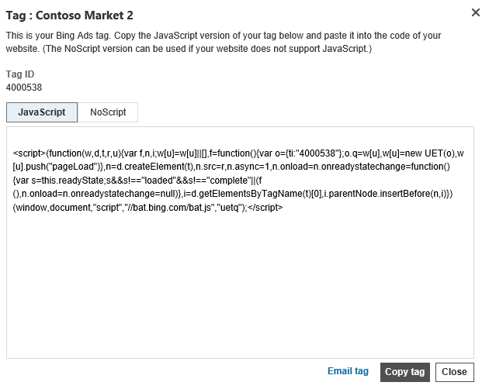
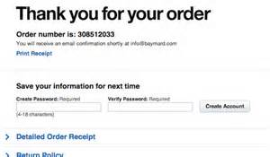

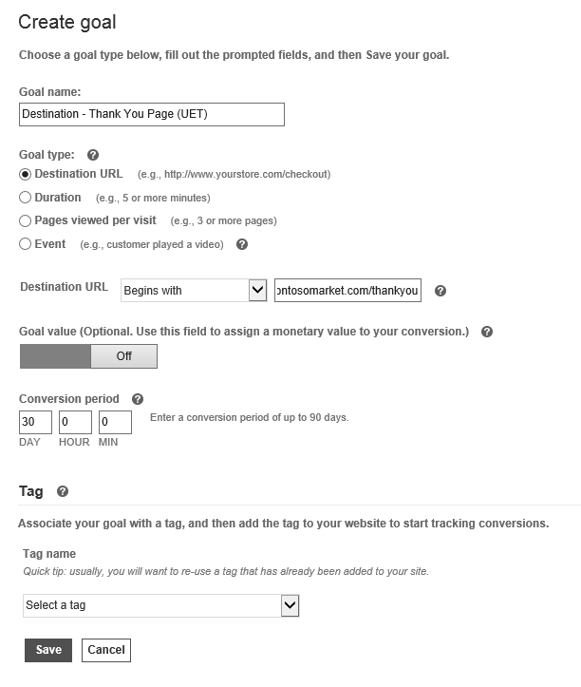
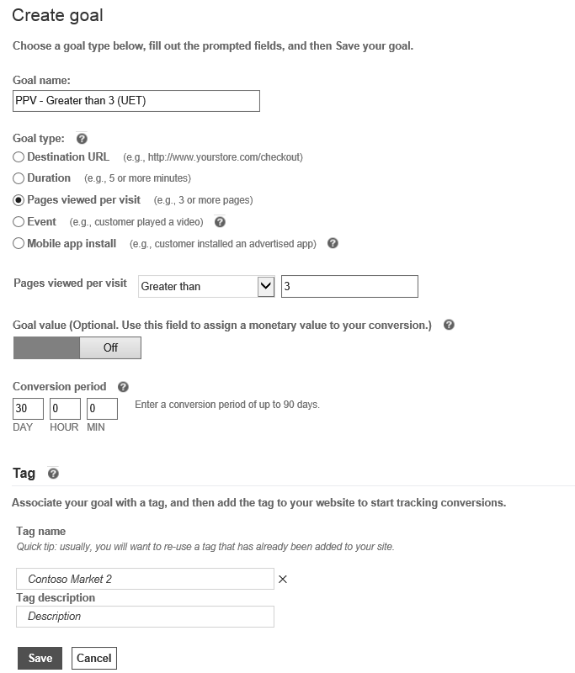
How Does Universal Event Tracking Work? Example
http://www.contosomarket.com
Connects BA with website
https://www.contosomarket.com/thankyou/12345
Contoso Market places the UET tag across their entire website
The UET tag tracks user behavior across the advertiser’s website
It is the connection between Bing Ads and Contoso’s website
Conversion
When the customer reaches a thank you page the UET tag and destination URL goal work together to report the conversion back to Bing Ads
Contoso Market
www.contosomarket.com
Come shop our newest Contoso products.
The customer visited the home page and two product pages in one visit
Contoso Market creates a goal in Bing Ads to report a conversion any time a customer reaches a Thank You page
They additionally create a goal to report a conversion any time a customer visits more than one page of their site
Conversion
If the customer also visits more than 3 pages during their visit to Contoso’s website the UET tag and PPV goal work together to report the conversion back to Bing Ads

Slide 8
What Goals Can A UET Tag Track?
One UET Tag can track
Customer purchases
Customer sign-ups
Customer call-back request
Customers contacting help
Customers viewing the contact us page
Customers viewing store locations
Customers using live chat
…and many, many more
Customers spending time playing a game or video on your site

Slide 9
Different Types Of Conversion Goals
Conversion Goals
UET Goals
Destination URL
Pages Per Visit
Non UET Goals
Offline Conversion*
Duration Per Visit
Custom Event*
Mobile App Install
Non – UET conversions do not require a UET tag to function, but have other pre-requisites in order to track conversions
Only two goal types require modifications to the advertiser site – Custom Event (requires a change to the UET tag) and Offline conversion (requires modifications to cookie data attached to a user)
Notes:
Destination Type
Definition: Can be used to track the number of users that visited a specific section or page of an advertiser’s site.
Example: User reached “Thank You for purchase” page after buying something from the site. (Illustrate each of these examples in their own slide)
Duration Type
Definition: Can be used to track the number of users that spent more, less or an exact amount of specified time on an advertiser’s site.
Example: User spent 10 min or more playing a game on your site.
Pages/Visit
Definition: Can be used to track the number of users that visited a specified amount of pages during a visit to the advertiser’s site.
Example: User flipped through all 10 pages of a catalog.
Custom Events
Definition & Fields: An event consists of values that you can use to describe a consumer’s interaction with an advertiser’s site.
Bing Ads automatically generates the needed information to track the first three goals. For custom events, you need to add some customized tracking information. Read Track conversions and other site goals with Universal Event Tracking to learn how to use the Universal Event Tracking tag and how to write your own code for custom events.

Slide 10
UET Goal Type : Destination URL
Track the number of users that visited a specific section or page of the website
Equal to
Defined URL
Tracked URLS
www.zappos.com/thankyou
www.zappos.com/thankyou
Use for exact URLs
www.zappos.com
www.zappos.com
Begins with
Defined URL
Tracked URLS
www.zappos.com/thankyou
www.zappos.com/thankyou
www.zappos.com/thankyou/orderid=1
Use to define the beginning of a URL that may change at the end
www.zappos.com/checkout/thankyou
www.zappos.com/cart
Goal:
Regular Expression
Defined URL
Tracked URLS
www.zappos.com/thankyou
www.zappos.com/thankyou
www.zappos.com/thankyou/orderid=1
www.zappos.com/thankyou/orderid=2
Use to define URL elements with certain patterns or text
www.zappos.com/thankyou
www.zappos.com/checkout/
Notes:
Destination Type
Definition: Can be used to track the number of users that visited a specific section or page of an advertiser’s site.
Example: User reached “Thank You for purchase” page after buying something from the site. (Illustrate each of these examples in their own slide)
Could also have three groups of people, site visitors, cart visitors, checkout confirmation visitors

Slide 11
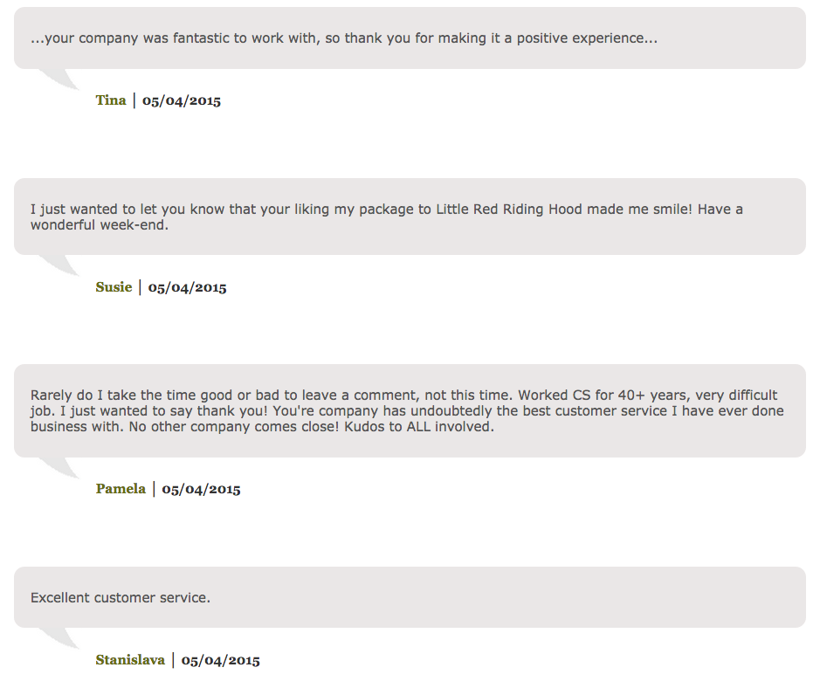
UET Goal Type : Duration Per Visit
Track number of of users who spent more, less, or an exact amount of specified time on a website
Goal:
People who spent more than 2 minutes reading customer testimonials
Notes:
Duration Type
Definition: Can be used to track the number of users that spent more, less or an exact amount of specified time on an advertiser’s site.
Example: User spent 10 min or more playing a game on your site.

Slide 12
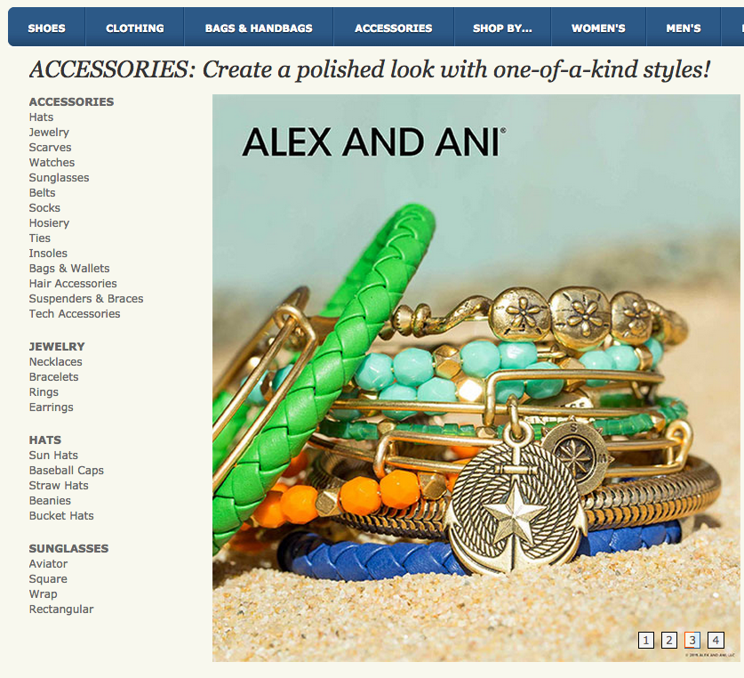
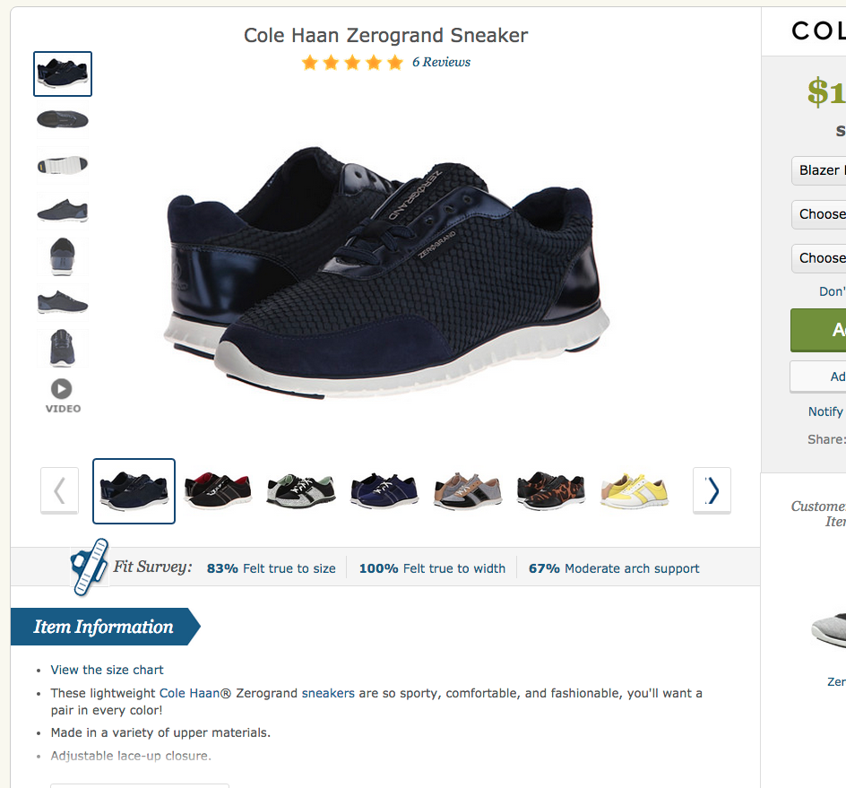
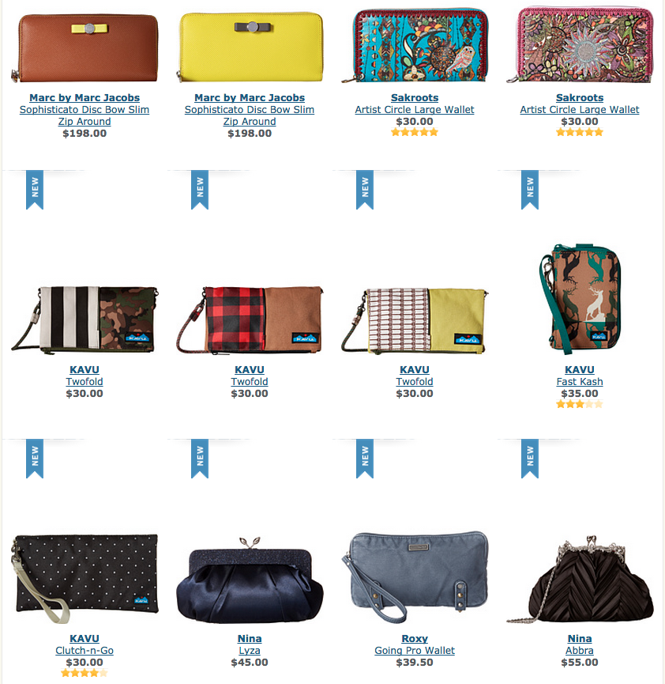
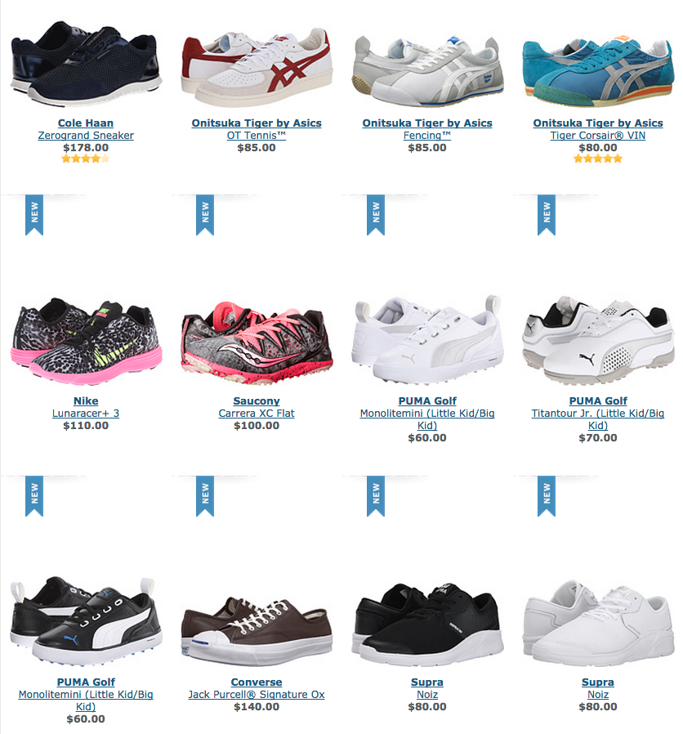
UET Goal Type : Pages Per Visit
Track the number of users that visited a specified list of pages during a visit to a website
Goal:
People who browsed 5 or more product catalogue pages
Notes:
Pages/Visit
Definition: Can be used to track the number of users that visited a specified amount of pages during a visit to the advertiser’s site.
Example: User flipped through all 10 pages of a catalog.

Slide 13
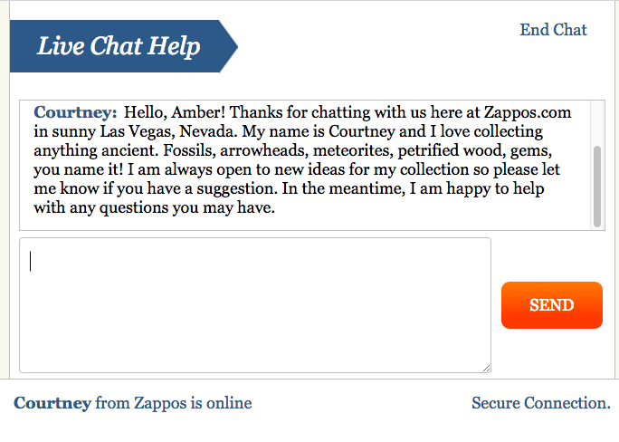
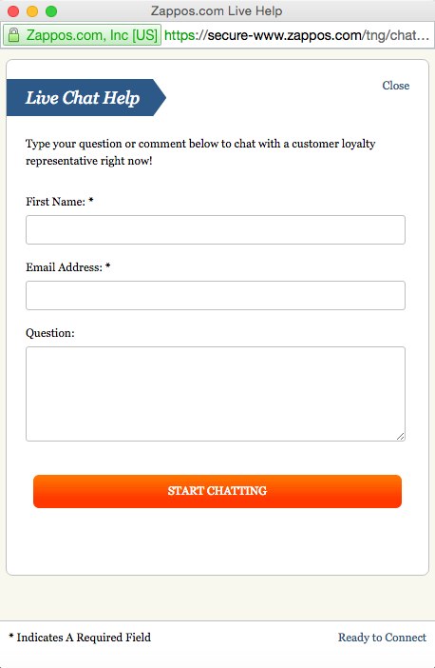


UET Goal Type : Custom Event
An event consists of values advertiser can use to describe a consumer’s interaction with the site
Goal:
People who started a live chat with customer support
Notes:
Custom Events
Definition & Fields: An event consists of values that you can use to describe a consumer’s interaction with an advertiser’s site.

Slide 14

Non UET Goal Type : Offline Conversions
Offline Conversions help track conversions that may have closed in-person or that were leads that may have converted later. Examples may include mortgage buying, insurance quotes, college enrollment, car buying and other forms of lead generation
Pre-requisites –
Requires a modification to advertiser’s site code that adds the ClickID to cookies
CRM software that tracks leads and attributes them to the ClickID from the cookie
Offline conversion data needs to be uploaded back to Bing Ads by the advertiser
Goal:
People who started a live chat with customer support
Better tracking
Track the impact of your campaigns across your online and offline channels.
Easy importing
The time, date, Click ID and goal name are all you need to get started.
Better ROI
Make campaign optimizations based on the full impact of your search ads.
Notes:
Custom Events
Definition & Fields: An event consists of values that you can use to describe a consumer’s interaction with an advertiser’s site.

Slide 15
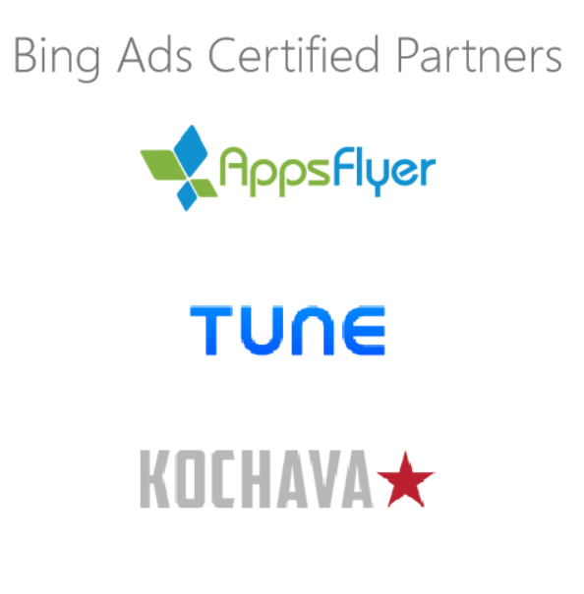


Non UET Goal Type : Mobile App Install
Tracks conversions by using the app-specific URL that is provided by the Bing Ads-certified partner
Does not require a UET tag to function
Only one conversion goal is required per app platform for each app, per advertiser
Works with the App Extension for Text ads, as well as the separate “App Install Ad” ad type
NOTE: The partner attributes conversions to an app install only AFTER the app is opened for the first time
Notes:
Custom Events
Definition & Fields: An event consists of values that you can use to describe a consumer’s interaction with an advertiser’s site.

Slide 16
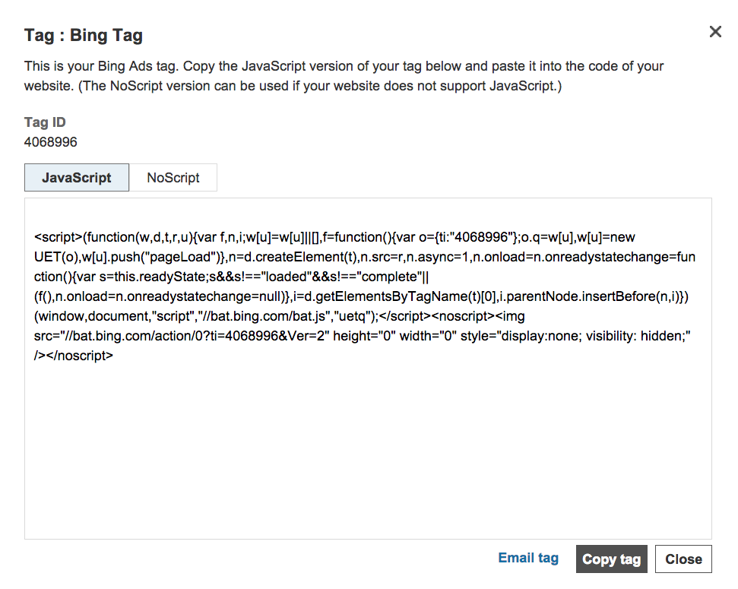
What Is the UET Tag?
The tag is a snippet of JavaScript that advertisers can add to their website’s code in order to track and measure user activity
Example
Notes:
What is it? The tag is a snippet of JavaScript that you add to the code of your website in order to track and measure user activity. The tag collects and sends data to Bing Ads when your webpage loads in a browser. Yours will probably look pretty similar to this.
What you need to know: With Universal Event Tracking, tags are defined at the customer level. This means that you can use the same tag to define and track goals across all your accounts and campaigns. There is no need to generate or add new tags to your site each time you add a new account/goal you want to track. The only exception is if you want to track an event goal- to track event goals, you'll need to manually write and add code to your website in addition to the Universal Event Tracking tag.
So now that we know *what* a tag is, how do we place it?

Slide 17
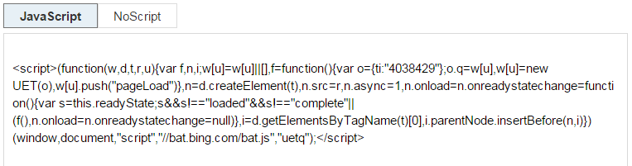
UET Tag Implementation
Easily deploy within Tag Manager* of advertiser’s choice
CODE
3rd party tag management solution
UET CODE
Or place across every page on the site
Notes:
Tag Manager : It’s a tag management system that allows you to quickly and easily update tags and code snippets on your website or mobile app

Slide 18
UET Tag Implementation – Tag Manager
The benefit of using a tag manager is that it allows advertisers to manage website tags in one place
UET will work with all industry ready tag management systems
The following table lists the current status of tested and supported tag managers for usage in UET:
Google Tag Manager
Qubit (Opentag)
Tealium
Ensighten
BrightTag (Signal)
Adobe Tag Manager
Notes:
.

Slide 19
UET Tag Implementation - Directly in Site Code
UET can be implemented directly on webpages
Go directly into the Bing Ads UI and set goals and tags
Take the JavaScript tag and implement it directly on a website
It can go anywhere on the page: header, body, or footer. It is recommended on the page, as it lessens the chance of another tag causing issues
PAGE
Tag
PAGE
PAGE
Notes:
To get started with UET, there are a couple ways to handle it:
.

Slide 20
Appendix

Slide 21
UET – Commonly Asked Questions
Why advertisers
need it at all?
What about compatibility with tag management tools?
Without insights into how campaigns are converting, making optimization adjustments is far more of a guessing game.
In addition, Bing Ads Remarketing becomes available to UET users.
Bing Ads is already compatible with Google Tag Manager, Adobe Tag Manager, Tealium, QuBit, Signal Digital (BrightTag) and Ensighten.

Slide 22
Reading UET data from Monetization View
Following snippet is used to get UET Conversions and related data from MV
Data =
VIEW @MonetizationView
PARAMS
(
StartDateTimeUtc = @StartDateTimeUtc,
EndDateTimeUtc = @EndDateTimeUtc,
ReadConversions = true,
ReadUETConversions = true
);

Slide 23
Explanation:
ReadConversion :
It allows access to Non-UET (MSN) logging
This should be set as TRUE to get Non-UET (MSN) conversion number
ReadUETConversions:
It allows access to UET logging
If only this field is set as TRUE and the other two (ReadConversion, ReadSession) are set as false then I,C,R values will be 0 and only conversion numbers will be populated in output
GoalId
GoalId is another field which can be used in the context of UET
For UET, GoalID will be not be equal to -1

Slide 24

Reference Links
UET Feature Guide: Link
Introductory Video:

